Slide 1

SHARING COMMON GROUND
LET’S
REBOOT

Slide 2
NEW REPORTING SYSTEM
WHY??
OLD REPORTS
    DO NOT CAPTURE CURRENT TRENDS
    ARE NOT BEING SUBMITTED
    DO NOT ALLOW FOR PLANNING
    LET’S REBOOT
    WE WANT TO HEAR WHAT YOU ARE DOING

Slide 3
CATEGORY GUIDE
COMMUNUITY DEVELOPMENT
DISASTER RESPONSE
EMOTIONAL/SPIRITUAL
TUTORING AND MENTORING
SENIOR/OLDER ADULTS
URBAN OUTREACH
YOUNG ADULT EMERGENCY SERVICES

Slide 4
ADVENTIST COMMUNITY SERVICES
MONTHLY REPORTING CATEGORY GUIDE
CMD | COMMUNITY DEVELOPMENT
CMD-100 | Community Resource | Events/activities pertaining to community access to resources and services; new neighbour support; charity fundraiser; clean community projects; fun fairs, community fundraisers, etc.
CMD-200 | Education and Training | Skills training classes, job search, resume writing classes, school backpacks/supplies for economically struggling families, etc.
CMD-300 | Family Support | Activities which assist economically struggling families such as personal care kits, provision of home care, love and care services, temporary shelter, babysitting, baby clothes/blankets/ care items, small appliances, etc.
CMD-400 | Food Pantry | Collection and provision of food; community meals; touch of love; soup kitchens; meal vouchers; meals on wheels; Tim's cards; food stamps/coupons, etc.
CMD-500 | Health Programs | Activities that will improve/promote healthy living such as blood donor clinics, nutrition classes, cooking classes, stop smoking programs, yoga/exercise classes, disease prevention, etc.
CMD-900 | Other | Other community development activity not included above

Slide 5
DISASTER RESPONSE
DRP | DISASTER RESPONSE
DRP-600 | Emergency - Use of Church | Opening church for public use in cases of emergency need for shelter from storms, severe weather, fire, flood, other natural disaster or traumatic event affecting the community
DRP-620 | Disaster Preparedness and Training | Sponsorship of people to attend disaster response training; preparation of preparedness plans; inventory/assessment of resources needed for emergency
DRP-630 | Emergency Response | Activities pertaining to a traumatic event or disaster (fire, flood, storm, etc.) where there is a need for: food, non perishable Items, personal hygiene kits (brush, toothbrush, paste, washcloths, shampoo, diapers, depends, etc.) ; assistance with clean-up, repairs, rebuilding, etc.
DRP-900 | Other | Other disaster response activity not included above

Slide 6
EMOTIONAL/SPIRITUAL
SUPPORT
EMSP | EMOTIONAL/SPIRITUAL SUPPORT
EMSP-100 | Community Resource | Events involving public partners to build awareness of programs and services available to support mental and spiritual health
EMSP-200 | Education and training resources | Seminars/Workshops/materials aimed to help provide community with emotional and spiritual development
EMSP-500 | Spiritual care/prayer | Nurturing and spiritual care of individuals in times of illness and crisis; prayer shawl ministry; hospital visits; Prayer Warriors; etc.
EMSP-700 | Support groups | Seminars/workshops/support groups aimed to assist individuals grieving the loss of loved ones, crisis/stress management, autism awareness, caretaker support, veteran support, depression recovery, disability awareness, domestic abuse, etc.
EMSP-900 | Other | Other emotional or spiritual support activity not included above

Slide 7
TUTORING/MENTORING
TUM | TUTORING/MENTORING
TUM-200 | Education and training programs | Facilitate seminars for English language training, immigrant support of second language, anti-bullying awareness, etc.
TUM-500 | Mental Health Awareness and Support | Activities, workshops, events, written pamphlets, posters, for the purpose of mental health awareness; support; suicide prevention; anti-bullying campaigns; hotlines; plans of action; etc.
TMN-900 | Other | Other tutoring/mentoring activity that doesn't fit in category above

Slide 8
SENIORS/OLDER ADULTS
SEN | SENIOR/OLDER ADULTS
SEN-100 | Community Resource | Resource centre for information on senior care, promotion of events targeting seniors, senior home visitation, day tripping, senior picnics, etc.
SEN-200 | Education and Training | Activities to help seniors with computer skills, online shopping, will and estate preparation, funeral pre-planning, mental health awareness, etc.
SEN-300 | Senior/Personal Home Support | Activities pertaining to seniors-at-home management such as running errands, grocery shopping, house cleaning/repairs and painting; outdoor lawn/garden maintenance, flower planting, snow removal, changing lights, hanging pictures, installing smoke alarms, window cleaning, etc.
SEN-500 | Senior Personal Health | Activities pertaining to the personal health, care, and safety of seniors such as buddy home watch programs; meal preparation/delivery; establish bank of personal care equipment such as walkers, canes, chair lifts or matching fund assistance to purchase/install; disability access ramps, assistance to dental/medical apts., etc.
SEN-900 | Other | Other activity for seniors that not included above

Slide 9
URBAN OUTREACH
URB | URBAN OUTREACH (Specific to Urban Centres only)
URB-100 | Community Resource | Activities/events specifically focused on outreach within urban centres (fairs, fundraisers, etc.)
URB-200 | Education and Training | Activities to assist parents in urban canters with education, job search, resume building, Interview practice, etc.
URB-300 | Family Support | Activities that pertain to assisting single parents and low income families in urban canters with necessary non-perishables and food staples, appliances, as well as support with information on domestic abuse prevention, etc.
URB-500 | Health Programs | Cooking and nutrition classes, parenting, pre/post natal support, yoga and/or fitness classes, education in healthy living, etc.
URB-900 | Other | Other activity involving urban outreach not included above

Slide 10
YOUTH ADULT EMERGENCY SERVICES
YES | YOUTH ADULT EMERGENCY SERIVCES (YES)
YES-200 | Education in Service | Activities specifically aimed to involve youth in volunteer practices to help seniors, child care, feeding patrons, reading programs; Community clean-up, volunteer at schools, shelters, cross walk duty, parking, etc.
YES-900 | Other | Other activity involving youth not included above

Slide 11

TRANSPORTATION
TRAN | TRANSPORTATION
TRAN-800 | Transport | Costs pertaining to travel expenses incurred undertaking any of the above activities for example gas, bus tickets, parking passes, etc.

Slide 12
CHURCH REPORT
TO BE COMPLETE EACH MONTH
RECORD ACTIVITIES AND FUNDS SPENT
RECORD # OF HOURS
RECORD # VOLUNTEERS
RECORD # OF PEOPLE HELPED
STORIES AND PICTURES

Slide 13
 | ADVENTIST COMMUNITY SERVICES
 | MONTHLY ACTIVITY REPORT
CHURCH NAME ________________________________________ |  |  |  |  |  |  | ACTIVITY FOR MONTH OF _______________
CONTACT NAME ___________________________________ |  |  |  |  |  |  | EMAIL _______________________________
POSITION AT CHURCH ___________________________________ |  |  |  |  |  |  | PHONE ______________________________
 | SECTION 1: FOCUS GROUP | √ | 0-13 years | 14-25 years | 26-50 years | 51-80+ years | Total | DETAILS ON FOCUS GROUP(S)
 | Female
 | Male
 | Total

Slide 14
RECORDING ACTIVITIES
CAT CODE | SECTION 2: ACTIVITIES | √ | FUNDS SPENT | # HOURS | # OF VOL | # HELPED | ACTIVITY DETAILS
 |  |  |  |  |  |  | Briefly explain what activity you achieved.
CMD | COMMUNITY DEVELOPMENT
CMD-100 | Community Resource
CMD-200 | Education and Training
CMD-300 | Family Support
CMD-400 | Food Pantry
CMD-500 | Health Programs
CMD-900 | Other

Slide 15



PARTNERS
PARTNER | SECTION 3: PARTNERSHIPS | √ | ITEM(S) PROVIDED | NAME OF PARTNER(S)
PART1 | Church
PART2 | Organization
PART3 | Local Charity
PART4 | Other
Provide details on how you are working with the above mentioned partner(s).

Slide 16
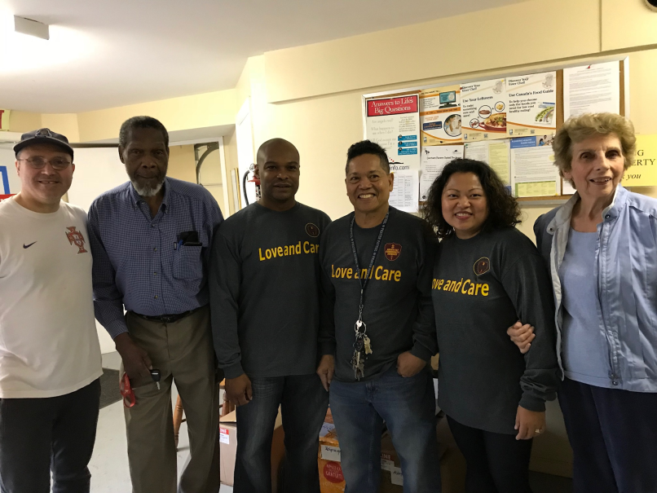
STORIES AND PICTURES
SECTION 4: STORIES/PICTURES
Provide pictures and stories of participants and activities your church has taken part in.

Slide 17
PURPOSE FOR REPORTING
REPORTING ON COMMUNITY ACTIVITES WILL PROVIDE INFORMATION TO BETTER
    TRACK ACTIVITIES
    TARGET TRAINING NEEDS
    DEVELOP RESOURCES
    IDENTIFY LESSON LEARNED
    BETTER PROGRAMS AND SERVICES

Slide 18
PURPOSE
ONTARIO CONFERENCE OF SEVENTH-DAY ADVENTISTS
COMMUNITY SERVICES DEPARTMENT
ACTIVITIES FOR THE QUARTER : __________________ |  |  |  |  | 2018
Church Name | Membership | Community Development | Disaster Response | Emotional/ Spiritual Support | Mentoring | Seniors | Urban | Youth | Total Funds Spent | # Volunteer Hours | # Helped
Bowmanville | 400 | $200.00 | $100.00 | $100.00 | $50.00 | $50.00 | $50.00 | $50.00 | $600.00 | 5 | 150
College Park | 1000 | $1,000.00 | $100.00 | $0.00 | $0.00 | $500.00 | $50.00 | $75.00 | $1,725.00 | 15 | 500
Kendalwood | 560 | $200.00 | $0.00 | $0.00 | $0.00 | $0.00 | $0.00 | $0.00 | $200.00 | 10 | 85
Toronto Chinese | 200 | $150.00 | $200.00 | $0.00 | $120.00 | $0.00 | $0.00 | $0.00 | $470.00 | 8 | 30
Windsor | 400 | $400.00 | $100.00 | $50.00 | $100.00 | $0.00 | $0.00 | $100.00 | $750.00 | 22 | 200
 |  |  |  |  |  |  |  |  | $0.00
 |  |  |  |  |  |  |  |  | $0.00
 |  |  |  |  |  |  |  |  | $0.00

Slide 19


QUESTIONS

Slide 20
College Park Church

Slide 21
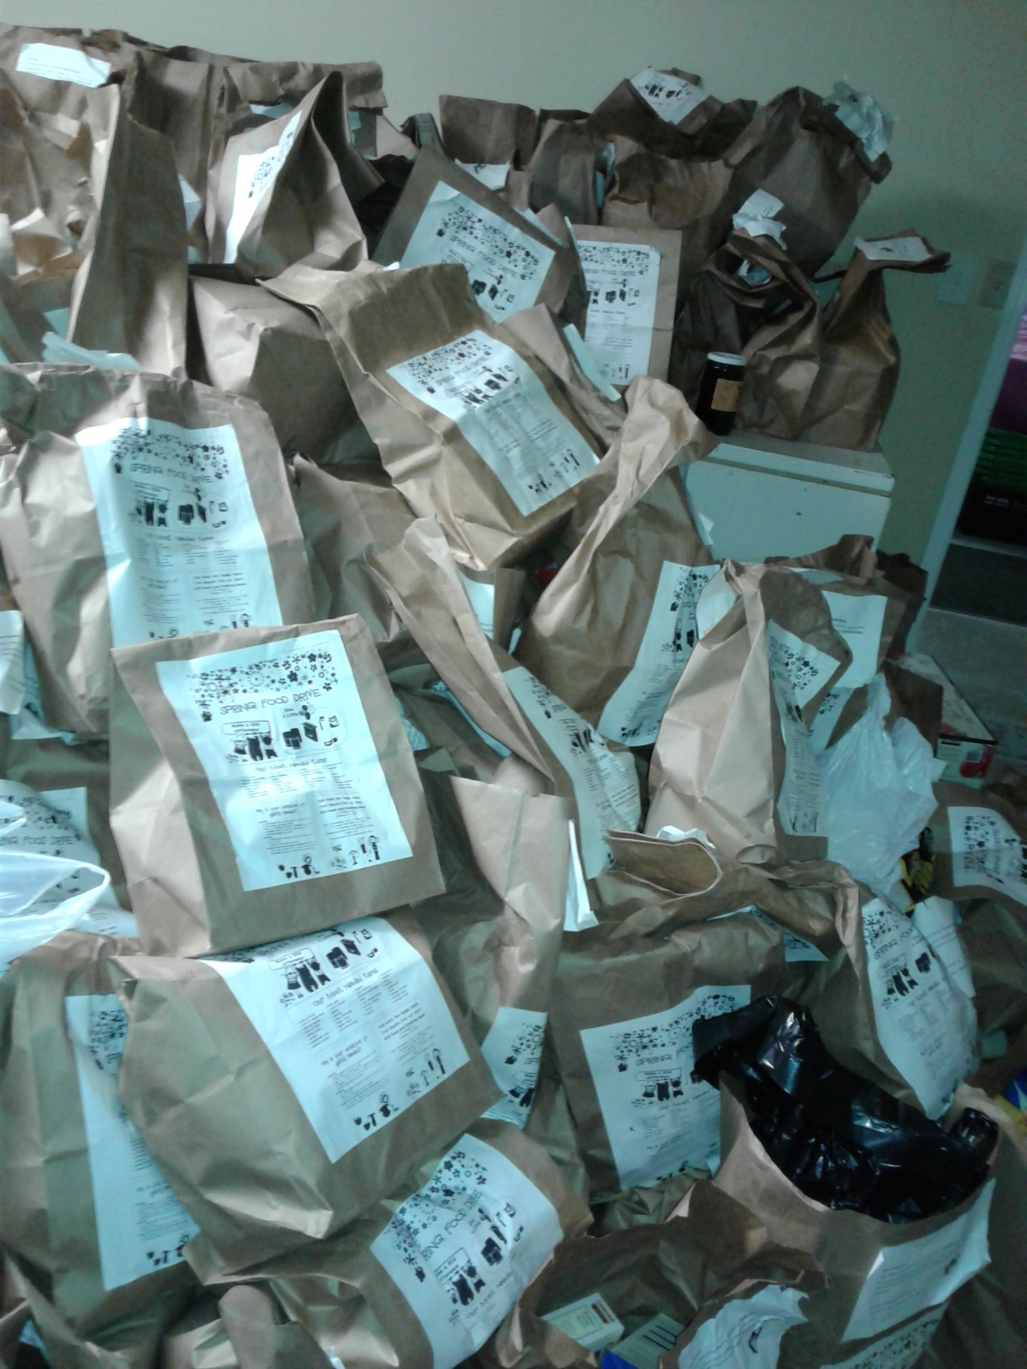
Ready for sorting

Slide 22
